Slide 1
College Management System
Presented by
Snehalakshmi.p

Slide 2
Technologies Used
BACK END:
Spring boot
Hibernate
My Sql
FRONT END
Angular
Html

Slide 3
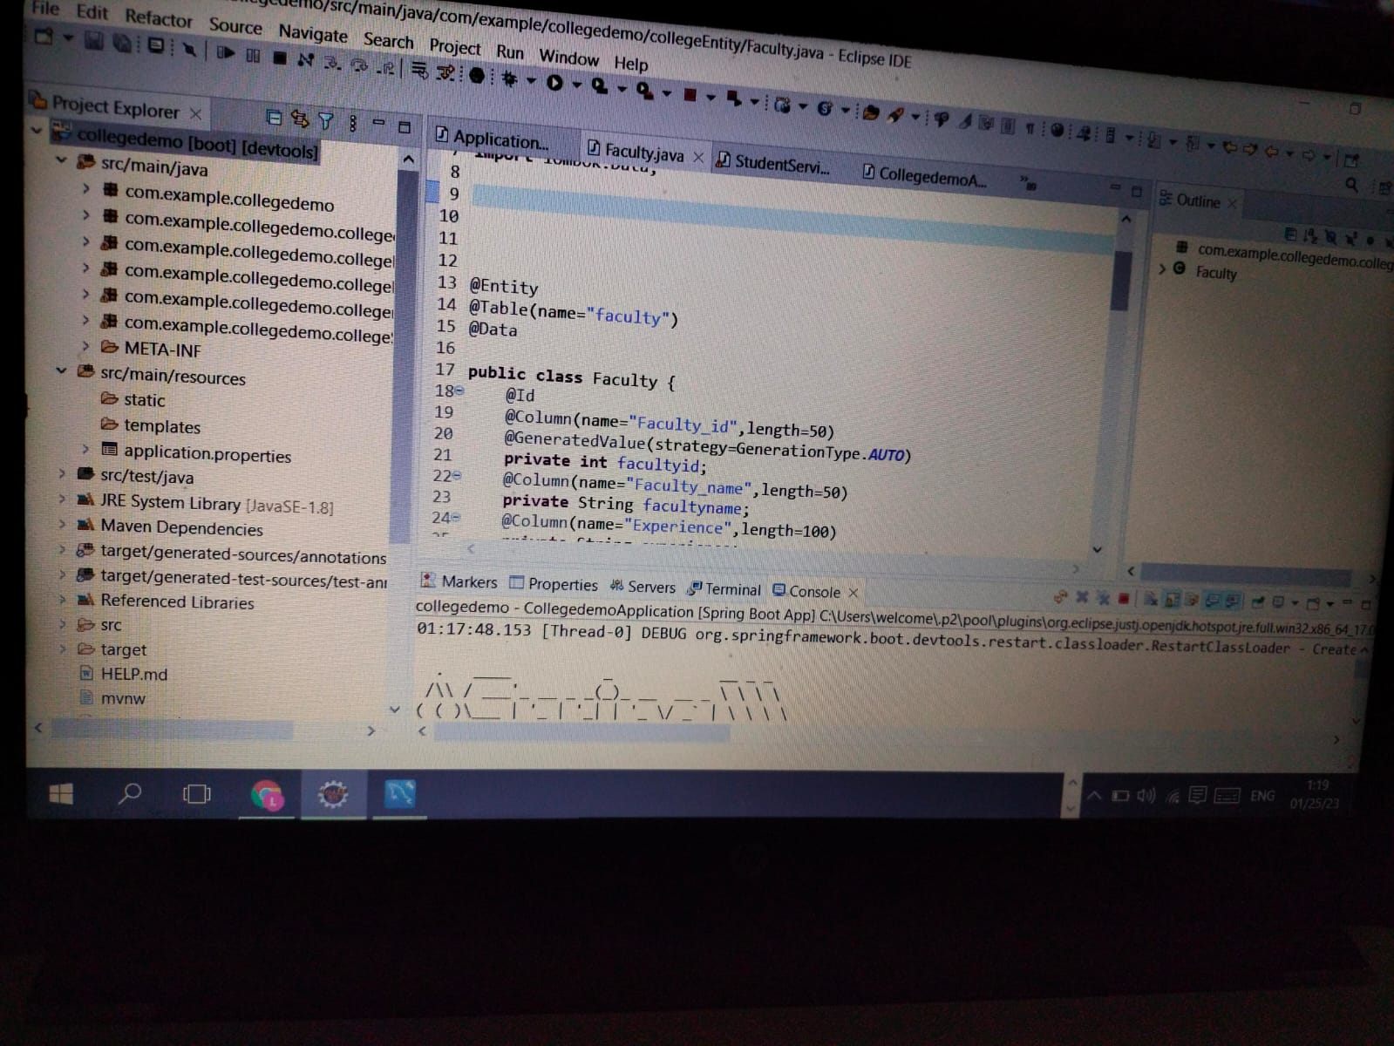

Slide 4
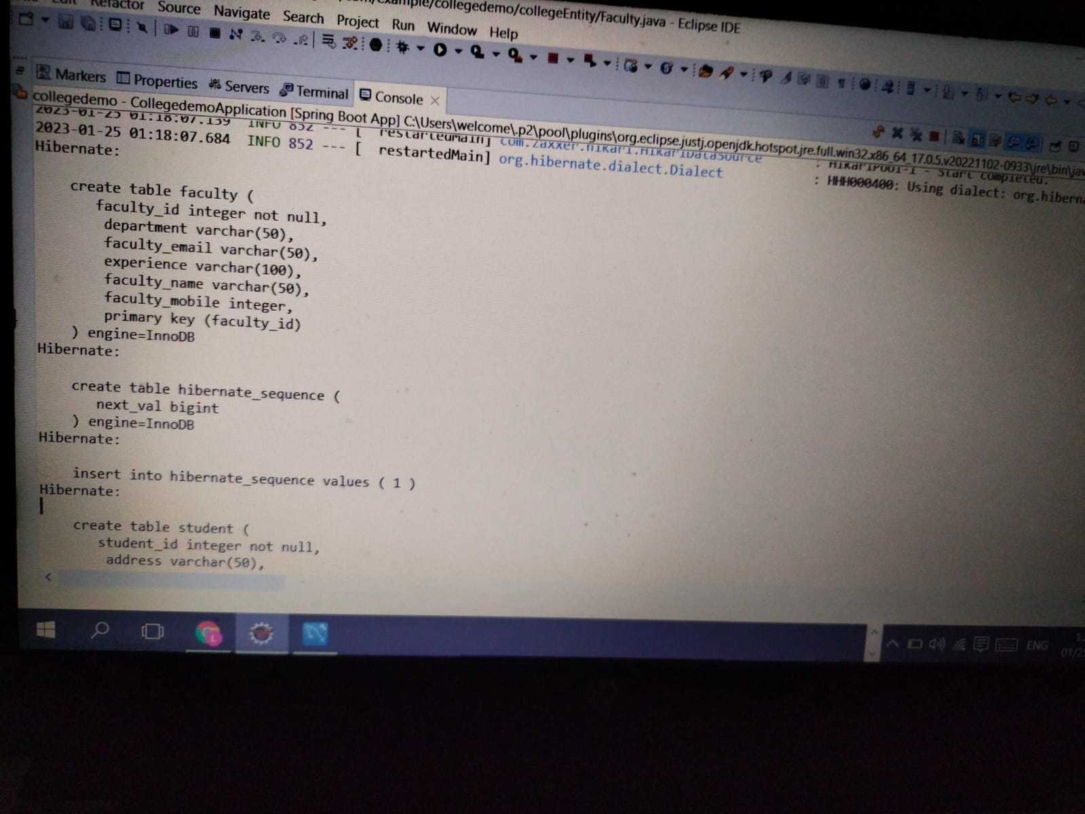

Slide 5
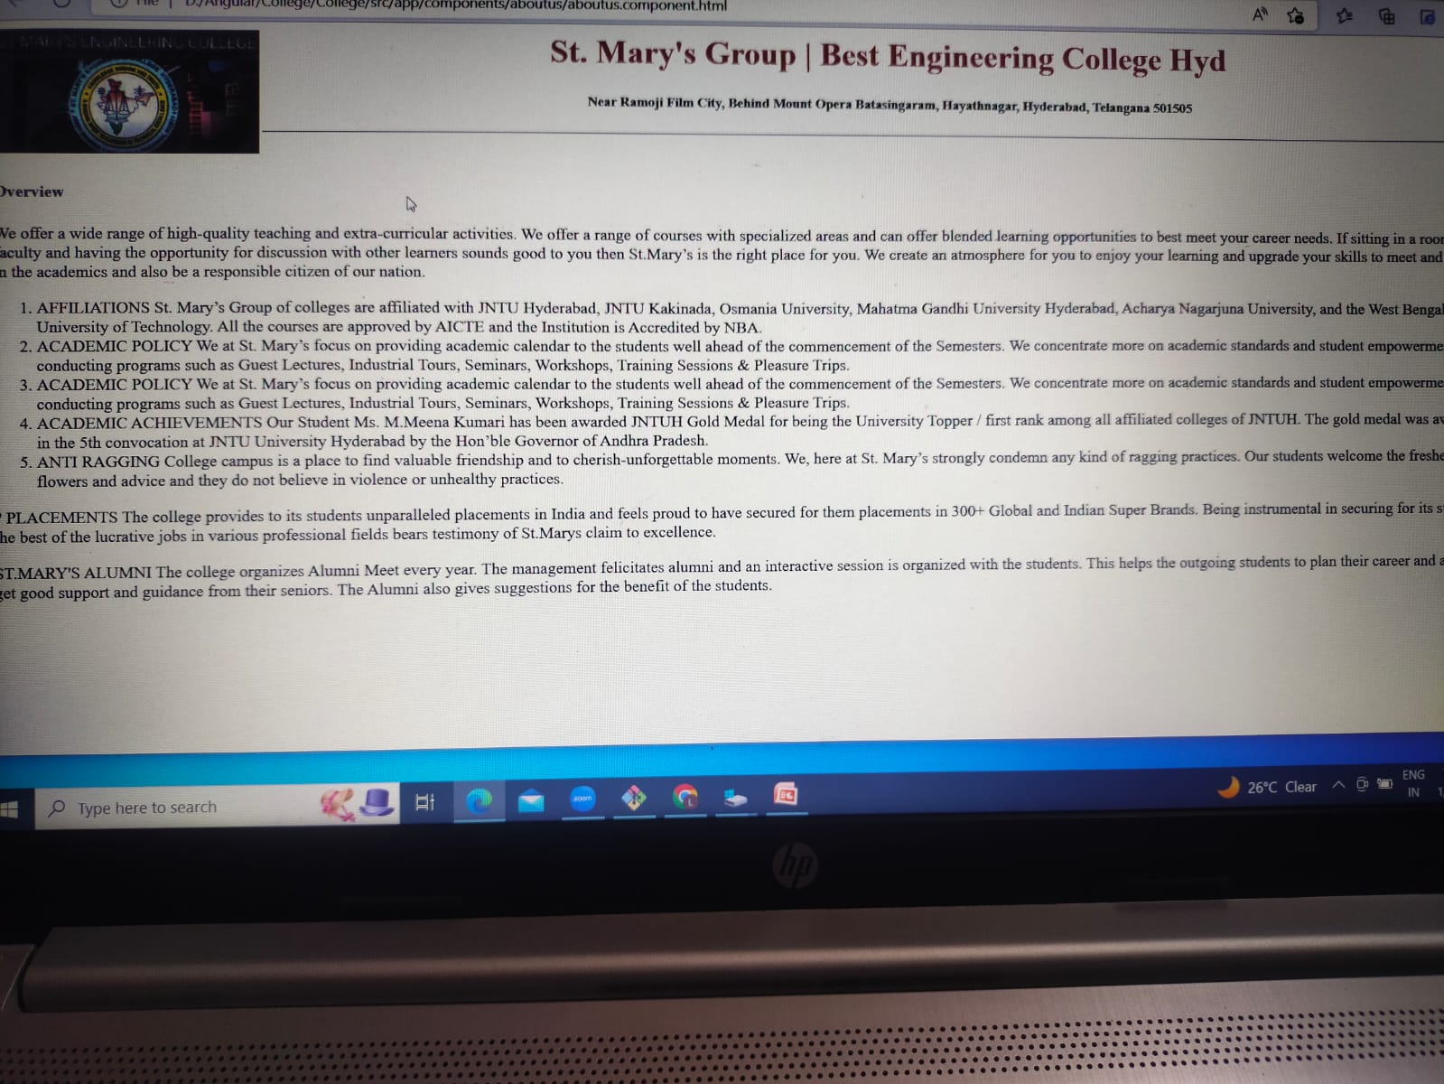
About

Slide 6
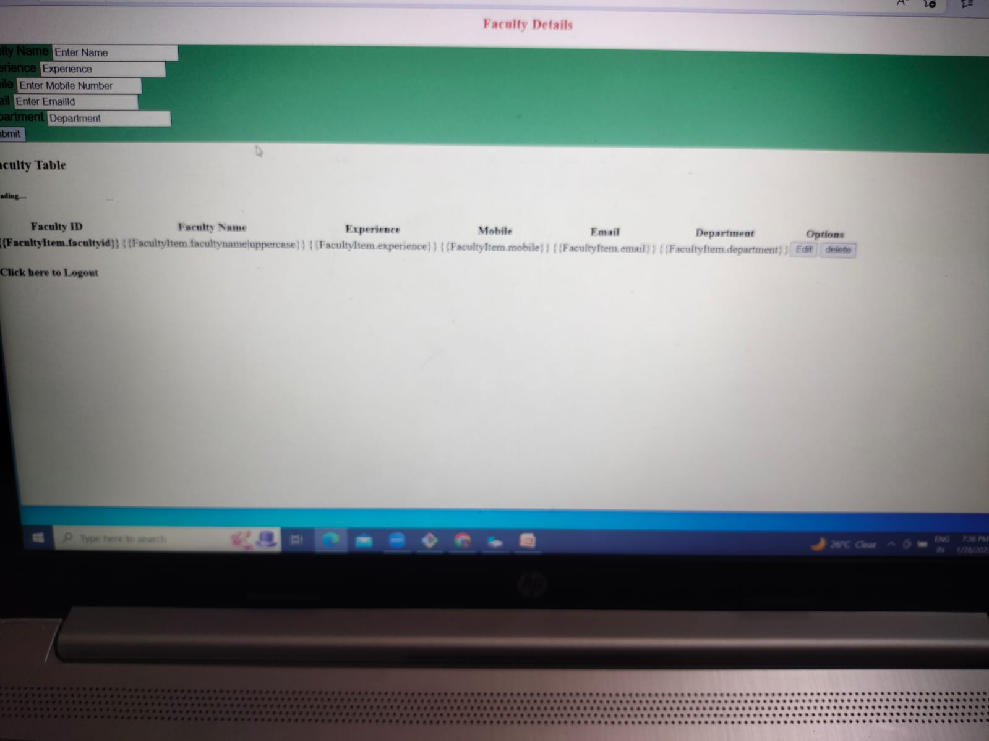
Faculty Details

Slide 7
Thank you

